Slide 1

ALY6015 – Intermediate Analytics Predicting the Value of a Soccer Player
ALY6015 – Intermediate Analytics Predicting the Value of a Soccer Player

Slide 2
Project analysis slide 2
Project Analysis
PURPOSE
STATISTICAL MODELING
PROJECT
DATA CLEANING
COMPARING RESULTS
EXPLORATORY DATA ANALYSIS
CONCLUSION

Slide 3
PURPOSE
FIFA is followed by billions of fans worldwide. The revenue generated is not only from soccer matches but associated advertisement and merchandise as well. The key driving factor is the how much a player is rated as it drives not only the success in matches but also the viewership each player brings to the clubs. There are various features which drive the value of the players. Each year there is a bidding war for soccer players who transfer between clubs and this is a widely monitored activity in sports fans around the world.
This project will focus on predicting the value of the players.

Slide 4
DATA CLEANING
The dataset for the group project is FIFA Dataset available on Kaggle.com which has 89 features like age, nationality, fitness and other characteristics of the players. The data also includes ratings of almost 18,207 players in multiple positions on the soccer field.
Characteristics
Position Scores
Skill Scores
ID
Name
Age
Photo
Nationality
Flag
Overall
Potential
Club
Club Logo
Value
Wage
Special
Preferred Foot
International Reputation
Weak Foot
Skill Moves
Work Rate
Body Type
Real Face
Position
Jersey Number
Joined
Loaned From
Contract Valid Until
Height
Weight
LS
ST
RS
LW
LF
CF
RF
RW
LAM
CAM
RAM
LM
LCM
CM
RCM
RM
LWB
LDM
CDM
RDM
RWB
LB
LCB
CB
RCB
RB
Crossing
Finishing
HeadingAccuracy
ShortPassing
Volleys
Dribbling
Curve
FKAccuracy
LongPassing
BallControl
Acceleration
SprintSpeed
Agility
Reactions
Balance
ShotPower
Jumping
Stamina
Strength
LongShots
Aggression
Interceptions
Positioning
Vision
Penalties
Composure
Marking
StandingTackle
SlidingTackle
GKDiving
GKHandling
GKKicking
GKPositioning
GKReflexes
Release Clause

Slide 5
DATA CLEANING
Currency and symbols
Values like €, M, k and lbs removed
Converted data for height into centimeters
Converted integer values with ‘+’ sign to numeric values
The missing values in the dataset are imputed using the MICE package as a model cannot perform well if there are missing values. The missing values can be corrected by either omitting the missing values or by replacing missing values by mean, median or mode value for the respective columns or the imputation technique using MICE package. It will simulate all possible data patterns and assign the best value out of it that fits the missing columns.

Slide 6
DATA CLEANING
Before Missing Value Imputation
After Missing Value Imputation

Slide 7
EXPLORATORY DATA ANALYSIS
The scatter plot shows that there is a high linear relationship between wages and value of a player.
The bar graphs show that the highest number of players are mid-fielders and their value is also highest in the group. The other important feature is that the value of attacker and defenders is not significantly different but the number of defenders is almost twice the attackers.

Slide 8
EXPLORATORY DATA ANALYSIS
Agility, Goalkeeper reflexes as a skill is showing the highest correlation with the value of the players. But there are a lot of variables and it is not very clear which are the most distinctive and highly related variables in deciding the value of a player. This will be further improved by using the Principal Component Analysis (PCA) and regularization.

Slide 9
EXPLORATORY DATA ANALYSIS
Plotting dependent variable “Value” varies with predictor variables. This will give us a clear picture on how we should choose a regression model and how we can eliminate certain predictor variables that are of least importance and can scatter away our model from answering our business problem

Slide 10
EXPLORATORY DATA ANALYSIS
The distribution of Overall rating parameter as part of EDA is helpful to know how a higher Overall rating is restricted to almost one single player and the Overall rating for most players is scattered between 60-70. This was the inference made from the graph we have plotted as follows. These observations give us valuable insights on how parameters vary and how certain players receive huge wages and have high Value.

Slide 11
HYPOTHESIS TESTING
As part of our preliminary statistical analysis, a Hypothesis test has been conducted for checking if attackers is more than value of defenders.
Null Hypothesis: Average Value of Attackers is less than that of Defenders
Alternate Hypothesis: The average value of Attackers is greater than that of Defenders.
The confidence interval of 95%.
Welch Two Sample t-test
data: attack_sample and defend_sample
t = -0.82099, df = 47.934, p-value = 0.7921
alternative hypothesis: true difference in means is greater than 0
95 percent confidence interval:
-1.851658 Inf
sample estimates:
mean of x mean of y
1.770833 2.379333

Slide 12
LINEAR REGRESSION
Linear Regression for an Outfield Player
We have reduced the Position Scores to 3 major features
Forward
Mid Field
Defense
as a part of Feature Engineering, to reduce the number of features in the statistical modeling
After executing the multiple linear regression models, this is the best linear regression model
Call: lm(formula = Value ~ Release.Clause + Forward + Midfield + Defense + Height + Weight + Crossing + Finishing + HeadingAccuracy + ShortPassing + Volleys + Dribbling + Curve + FKAccuracy + LongPassing + BallControl + Acceleration + SprintSpeed + Agility + Reactions + Balance + ShotPower + Jumping + Stamina + Strength + LongShots + Aggression + Interceptions + Positioning + Vision + Penalties + Composure + Marking + StandingTackle + SlidingTackle, data = fifasample1)
Adjusted R-squared: 0.9586
p-value: < 2.2e-16
> AIC(firstreg1) [1] 50817.16 > BIC(firstreg1) [1] 51101.75

Slide 13
LINEAR REGRESSION
Linear Regression for an Outfield Player

Slide 14
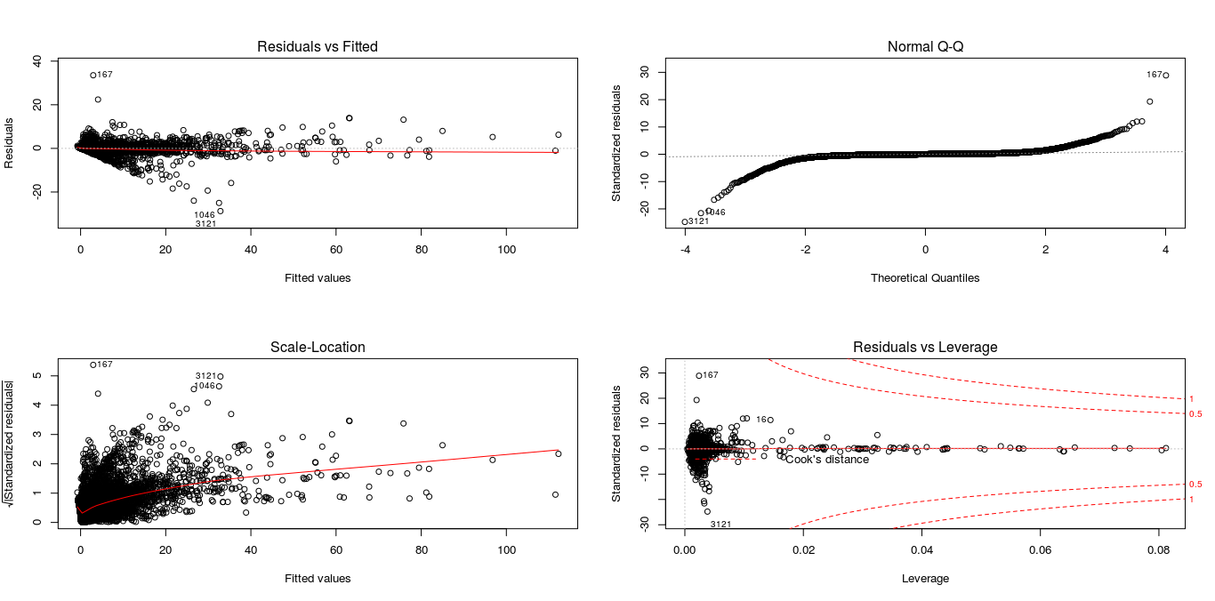
LINEAR REGRESSION
Linear Regression for an Outfield Player

Slide 15
LINEAR REGRESSION
Linear Regression for a Goalkeeper
As we have modeled two different models for an Outfield Player an another for a Goalkeeper, this model concentrates on Goalkeeper’s value.
This is because there are some features/variables which applicable only to Goalkeepers.
After executing the multiple linear regression models, this is the best linear regression model
Call: lm(formula = Value ~ Release.Clause + Forward + Midfield + Defense + Height + Weight + GKDiving + GKHandling + GKKicking + GKPositioning + GKReflexes, data = fifasample2)
Adjusted R-squared: 0.9749
p-value: < 2.2e-16
> AIC(firstreg2) [1] 4460.31 > BIC(firstreg2) [1] 4516.443

Slide 16
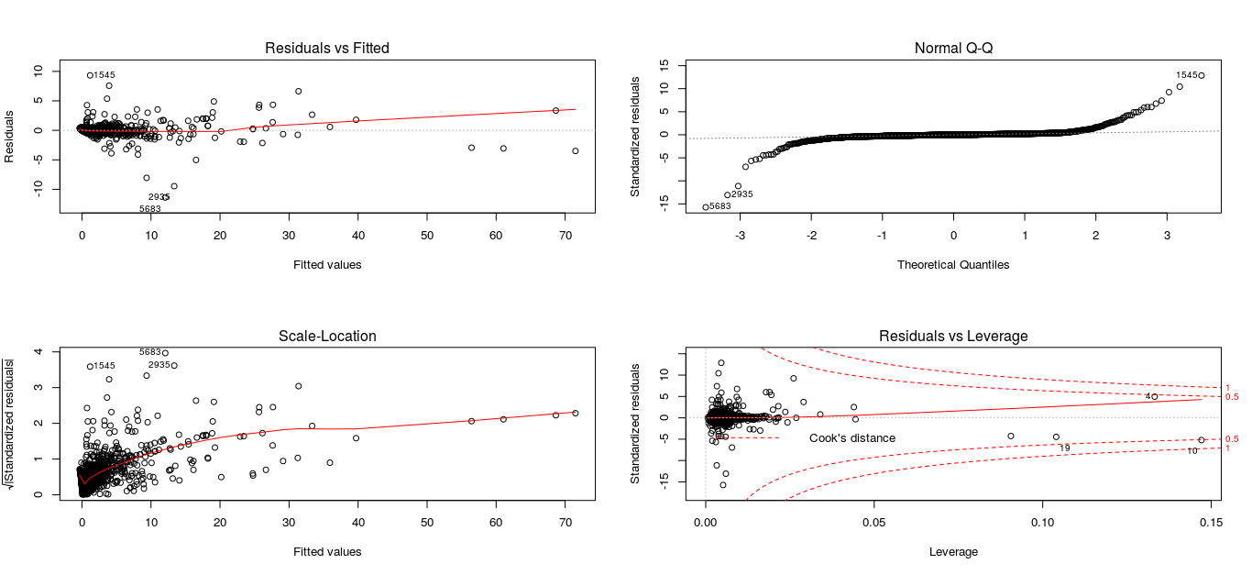
LINEAR REGRESSION
Linear Regression for a Goalkeeper

Slide 17
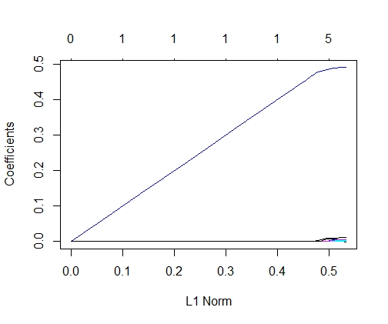
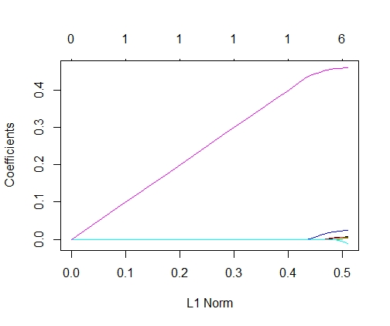
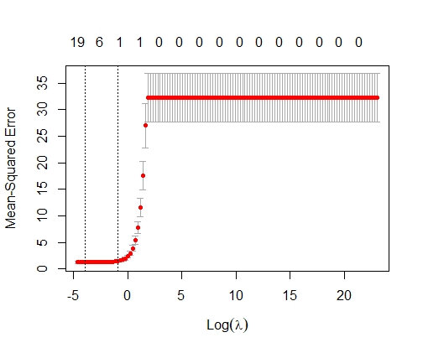
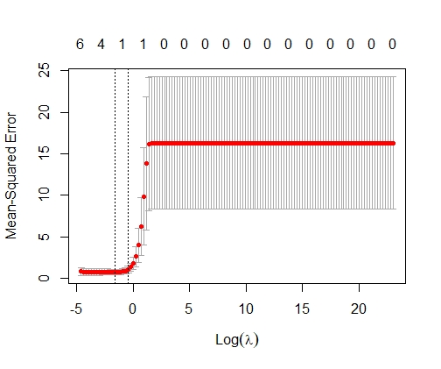
LASSO REGRESSION
LASSO performs regularization and variable selection on a given model by shrinking less relevant predictors to zero.
The best fit model is with the minimum value of lambda which is 0.01995262.
The second plot indicates that the cross validation curve. The beta matrix results show that some coefficients have shrunk to zero.
All players excluding Goalkeeper
Goalkeeper
35 x 1 sparse Matrix of class "dgCMatrix"
s0
Height | . | Agility | . | Marking | .
Weight | . | Reactions | 4.24E-03 | StandingTackle | .
Crossing | . | Balance | . | SlidingTackle | .
Finishing | . | ShotPower | 1.25E-03 | Release.Clause | 4.90E-01
HeadingAccuracy | 2.89E-03 | Jumping | . | Forward | 2.57E-03
ShortPassing | . | Stamina | 4.65E-03 | Midfield | 1.58E-08
Volleys | 9.61E-04 | Strength | 1.45E-03 | Defense | 9.78E-03
Dribbling | . | LongShots | . | Vision | .
Curve | . | Aggression | . | Penalties | .
FKAccuracy | . | Interceptions | . | Composure | .
LongPassing | . | Positioning | . | SprintSpeed | .
BallControl | . | Acceleration | .

Slide 18
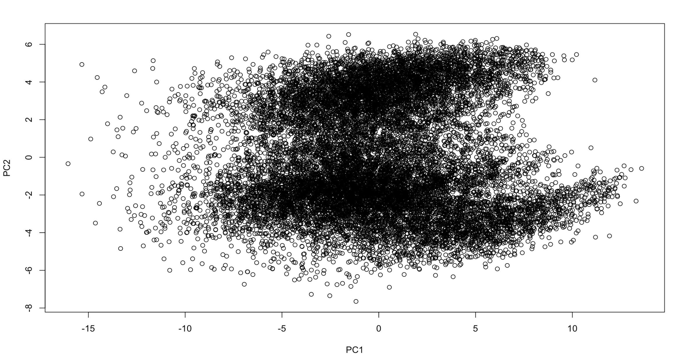
PRINCIPAL COMPONENT ANALYSIS
In the below PCA analysis and model, PC1-PC4 explain 95% of the variability in dataset with a very high AIC and BIC. The plot between PC1 PC2 is overlapping and not showing separately identifiable clusters as well.
Importance of components:
 | PC1 | PC2 | PC3 | PC4 | PC5 | PC6 | PC7 | PC8 | PC9 | PC10
Standard deviation | 4.9381 | 1.54235 | 1.33711 | 0.98689 | 0.94343 | 0.49446 | 0.47804 | 0.25055 | 0.19451 | 0.07008
Proportion of Variance | 0.7866 | 0.07674 | 0.05767 | 0.03142 | 0.02871 | 0.00789 | 0.00737 | 0.00202 | 0.00122 | 0.00016
Cumulative Proportion | 0.7866 | 0.86336 | 0.92103 | 0.95245 | 0.98116 | 0.98904 | 0.99642 | 0.99844 | 0.99966 | 0.99982
 | PC11 | PC12 | PC13 | PC14 | PC15 | PC16 | PC17 | PC18 | PC19
Standard deviation | 0.04557 | 0.0379 | 0.02968 | 0.02632 | 0.02208 | 4.88E-15 | 3.78E-16 | 3.78E-16 | 3.78E-16
Proportion of Variance | 0.00007 | 0.00005 | 0.00003 | 0.00002 | 0.00002 | 0.00E+00 | 0.00E+00 | 0.00E+00 | 0.00E+00
Cumulative Proportion | 0.99989 | 0.99993 | 0.99996 | 0.99998 | 1 | 1.00E+00 | 1.00E+00 | 1.00E+00 | 1.00E+00
 | PC20 | PC21 | PC22 | PC23 | PC24 | PC25 | PC26 | PC27
Standard deviation | 3.78E-16 | 3.78E-16 | 3.78E-16 | 3.78E-16 | 3.78E-16 | 3.78E-16 | 3.78E-16 | 3.78E-16
Proportion of Variance | 0.00E+00 | 0.00E+00 | 0.00E+00 | 0.00E+00 | 0.00E+00 | 0.00E+00 | 0.00E+00 | 0.00E+00
Cumulative Proportion | 1.00E+00 | 1.00E+00 | 1.00E+00 | 1.00E+00 | 1.00E+00 | 1.00E+00 | 1.00E+00 | 1.00E+00
 | PC28 | PC29 | PC30 | PC31
Standard deviation | 3.78E-16 | 3.78E-16 | 3.78E-16 | 3.73E-16
Proportion of Variance | 0.00E+00 | 0.00E+00 | 0.00E+00 | 0.00E+00
Cumulative Proportion | 1.00E+00 | 1.00E+00 | 1.00E+00 | 1.00E+00
> AIC - 82587.34
> BIC - 82633.4

Slide 19
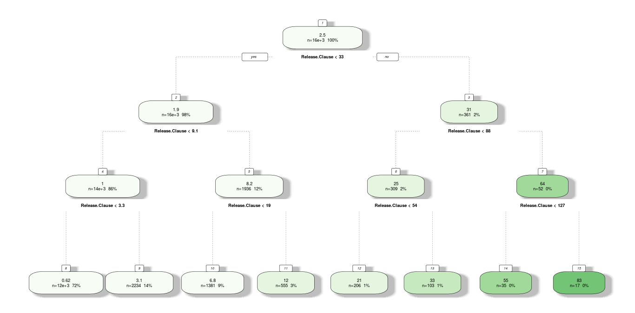
DECISION TREES
Decision Trees for an Outfield Player - We are using the same formula as we have used for the linear regression

Slide 20
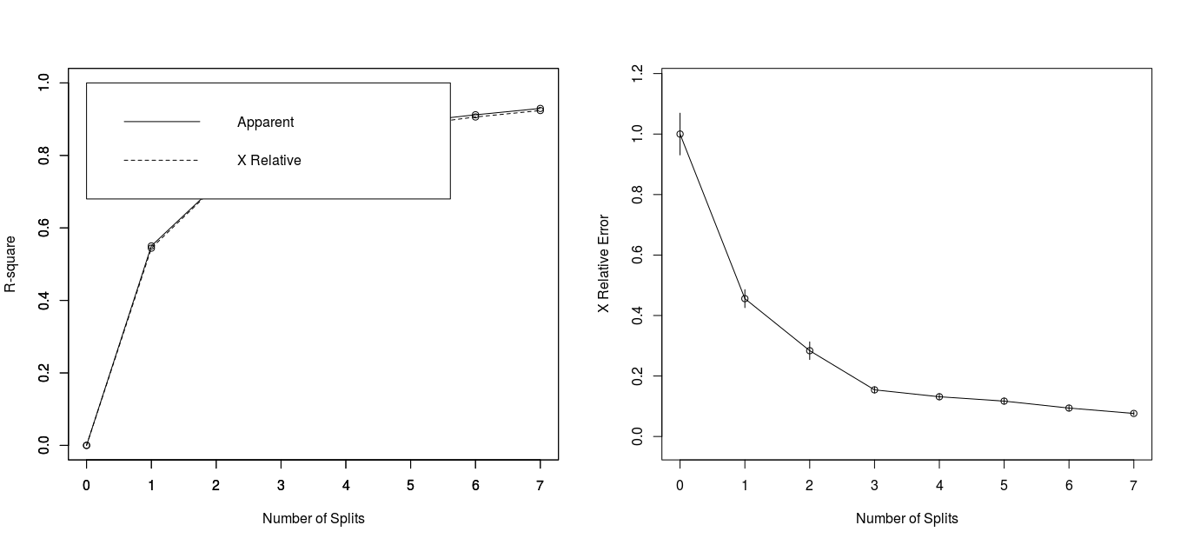
DECISION TREES
Decision Trees for an Outfield Player - We are using the same formula as we have used for the linear regression

Slide 21
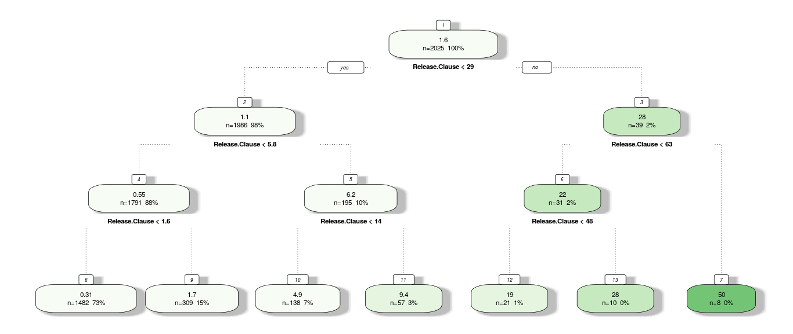
DECISION TREES
Decision Trees for a Goal Keeper - We are using the same formula as we have used for the linear regression

Slide 22
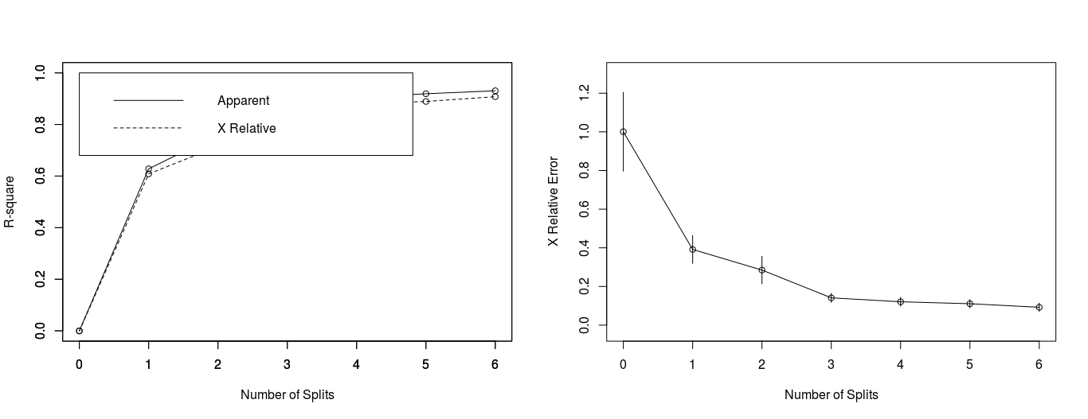
DECISION TREES
Decision Trees for a Goal Keeper - We are using the same formula as we have used for the linear regression

Slide 23
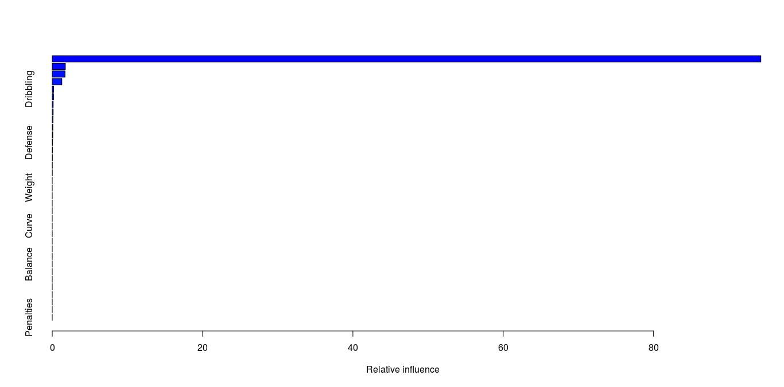
GRADIENT BOOST MODEL
Gradient boosting is a machine learning technique for regression and classification problems, which produces a prediction model in the form of an ensemble of weak prediction models, typically decision trees. It builds the model in a stage-wise fashion like other boosting methods do, and it generalizes them by allowing optimization of an arbitrary differentiable loss function.

Slide 24
RANDOM FOREST REGRESSION
Random forests were able to explain 96.5% of variance in our dataset . Evaluation of the model has been done 5 folds and 3 repetitions. Mean square residuals is about 0.832.
Call:
randomForest(x = x, y = y, mtry = param$mtry)
Type of random forest: regression
Number of trees: 500
No. of variables tried at each split: 8
Mean of squared residuals: 0.831767
% Var explained: 96.5

Slide 25
CONCLUSION
We have predicted the Value of a Soccer Player using multiple Regression Techniques and able to achieve an accuracy of ~96%
Out of which each Regression Technique has its own importance in conveying one information or the other. Linear Regression tells us how each Feature is affecting the Value of a player while LASSO Regression tells us what factors/variables are not necessary in the model
Decision Trees, Random Forests and Gradient Boosted Machine Regression Models tell us in what way the decision of Value is being considered for the player

Slide 26
REFERENCES
FIFA 19 complete player dataset. (2019). Retrieved 4 February 2020, from https://www.kaggle.com/karangadiya/fifa19
Correlation Test Between Two Variables in R - Easy Guides - Wiki - STHDA. (2020). Retrieved 5 February 2020, from http://www.sthda.com/english/wiki/correlation-test-between-two-variables-in-r Brownlee, J. (2019). Linear Regression for Machine Learning. Retrieved 7 February 2020, from https://machinelearningmastery.com/linear-regression-for-machine-learning/ Alice, M. (2016). Performing Principal Components Regression (PCR) in R. Retrieved 8 February 2020, from http://www.milanor.net/blog/performing-principal-components-regression-pcr-in-r/ Understanding Random Forest. (2020). Retrieved 2 February 2020, from https://towardsdatascience.com/understanding-random-forest-58381e0602d2

Slide 27
Thank You

